Slide 1
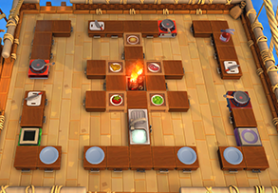
9.6
15.6
16.8
18.0
21.6
12.0
10.8
9.6
8.4
6.0

